Slide 1
Spill Prevention, Preparedness and Response Program
February 2016

Slide 2
Spill Responses (past 12 months)
Oil 2,860
Hazmat/Pollutant 1,157
Vessel Incident 105
Vessel Spill 29
Drug Lab 22
4,173
Vessel Incident
Hazmat/Pollutant
Oil

Slide 3
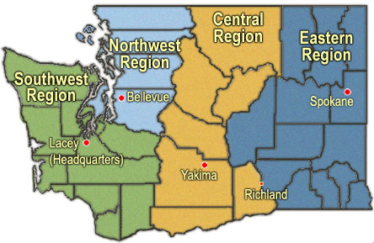
Response Staffing
Full-Time: 6.5
After-Hours: 5
Full-Time: 1
Full-Time: 7
After-Hours: 5
Full-Time: 1.5
After-Hours: 9
NRDA: 2
EQ Grant: 1
Full-Time: 1
After-Hours: 7
Full-Time: 2

Slide 4
Drills by County
CLALLAM | 14
CLARK | 9
COWLITZ | 1
FRANKLIN | 5
GRANT | 1
GREYS HARBOR | 4
ISLAND | 4
KING | 23
KITSAP | 1
MULTNOMAH | 16
PIERCE | 12
SAN JUAN | 8
SKAGIT | 6
SNOHOMISH | 1
SPOKANE | 5
VALDEZ CORDOVA | 2
WHATCOM | 10
Notes:
123 drijlls – worst case, deployment

Slide 5
Safe Oil Transportation ESHB 1449
Definition of “Oil” and “Facility”
Rail Spill Contingency Planning – Oct 2016
Advance Notice of Transfer – Oct 2016
Public Disclosure
Best Available Protection
Financial Responsibility Certification
Pilotage, Tug Escort, Safety Measures
Risk Assessment, Facility Permitting, Rules

Slide 6
Safe Oil Transportation ESHB 1449
Oil Spill Prevention Account
4 cents
Tank Vessels and Rail
Oil Spill Response Account Use
First Res ponder Equipment/Training
Equipment Distribution July 2016
Pipeline Contingency Plan Update
October 2016

Slide 7
Safe Oil Transportation ESHB 1449
Geographic Response Planning
Ongoing
UTC Inspection Program Funding
EMD Planners
Columbia River Risk Assessment
Preliminary Draft to Legislature: 6/2017
Complete Final Report: 6/2018

Slide 8
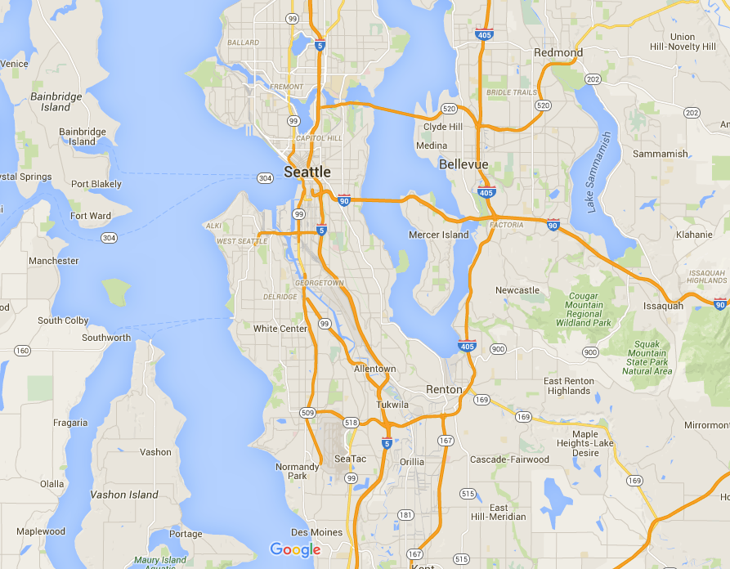
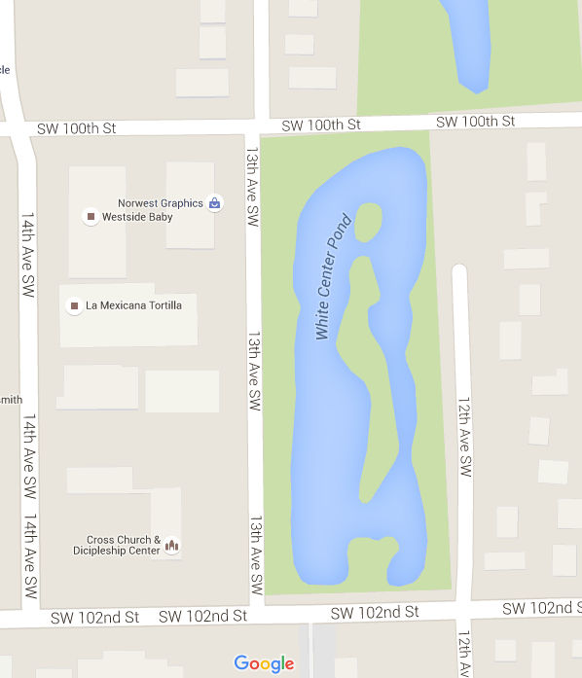
White Center Pond Spill
October 30, 2015
Reports of oiled birds, no initial spill report.

Slide 9
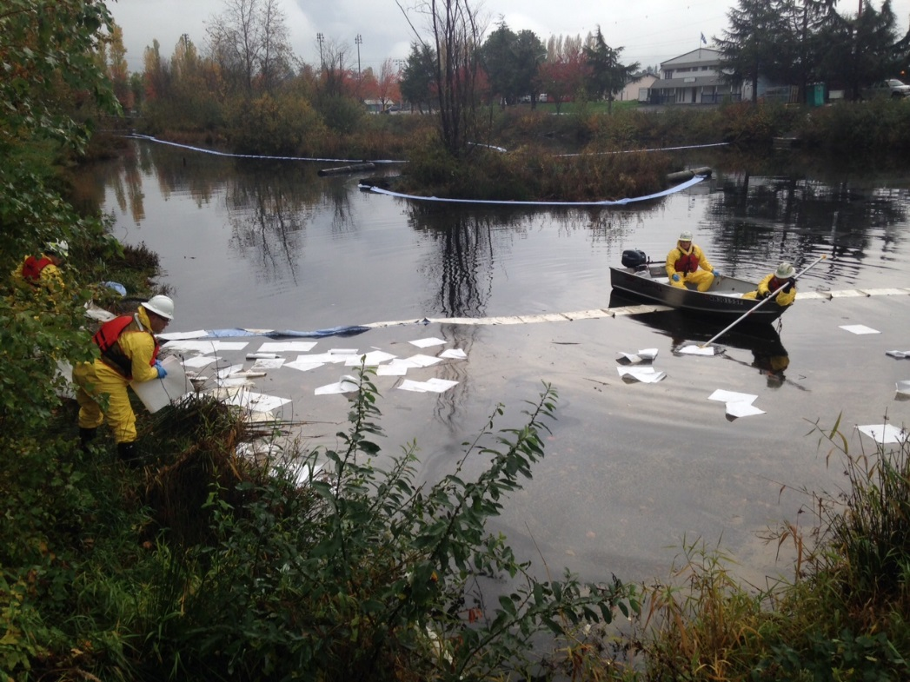
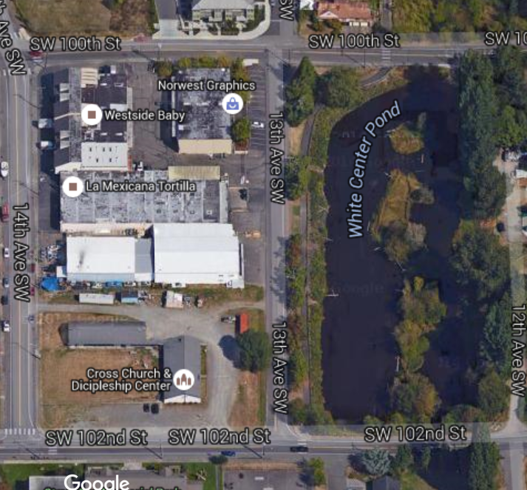
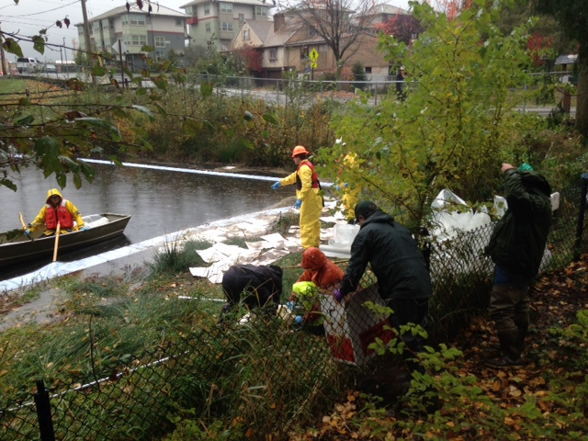

Slide 10
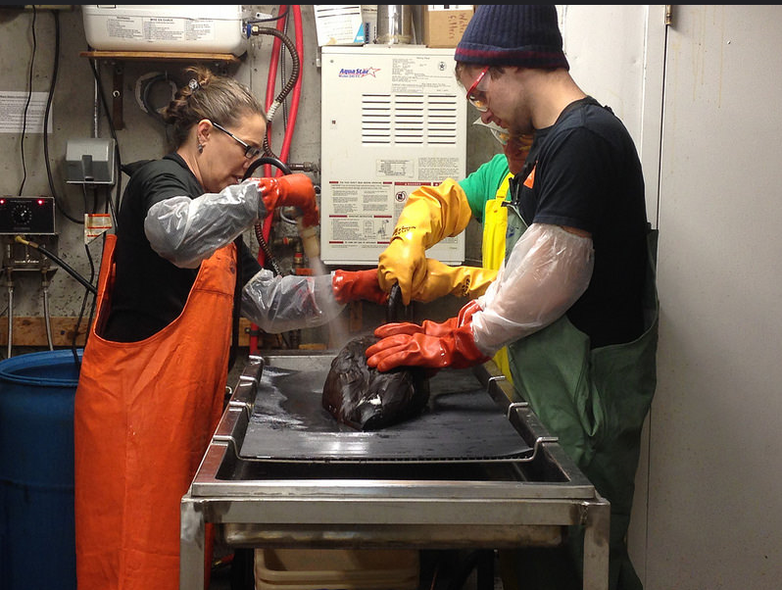
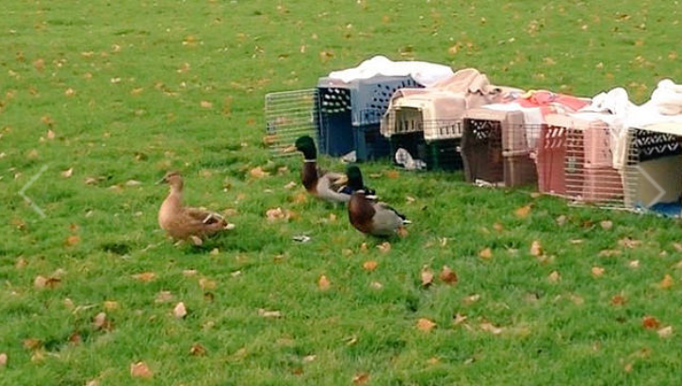
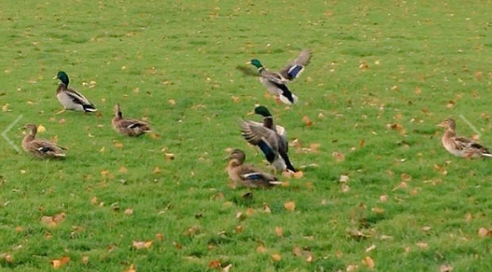
Wildlife Numbers
84 Live birds admitted to care
38 Geese
46 Mallards
80 Released
4 Mortalities

Slide 11
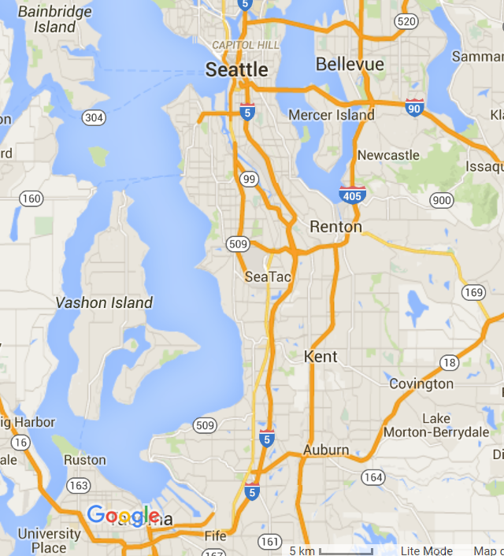
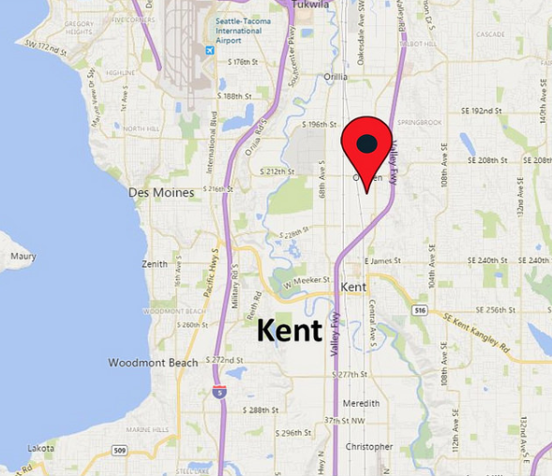
Kent Waste Oil Spill
December 27, 2015
Approximately 250 - 300 gallons of waste oil, midnight dumping
Wildlife Impacts

Slide 12
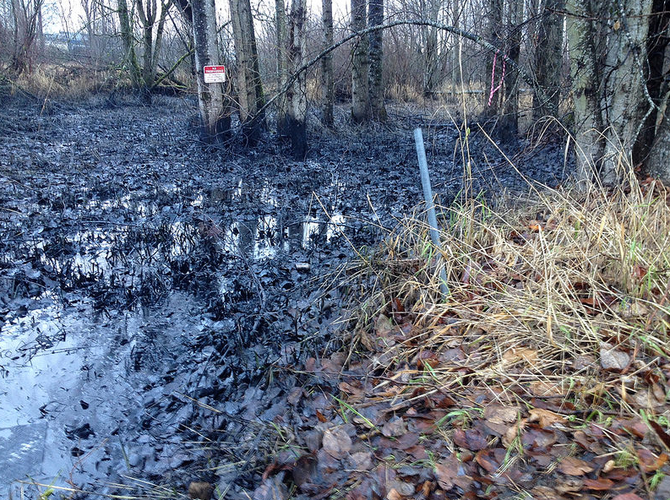

Slide 13
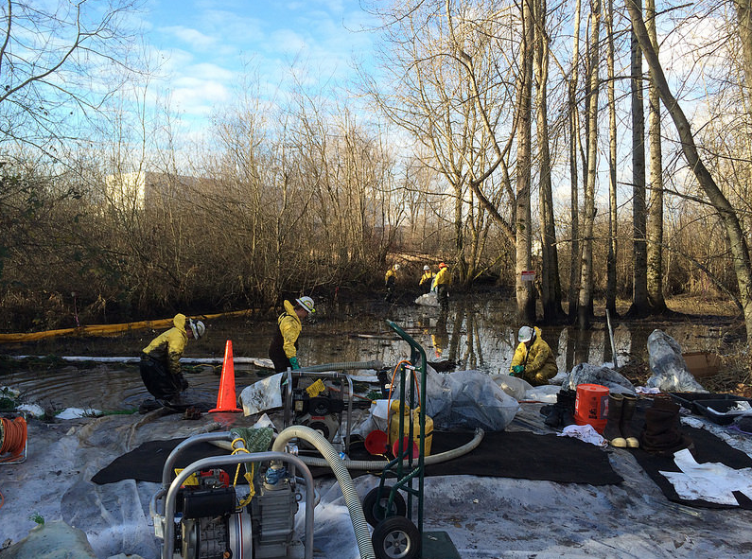
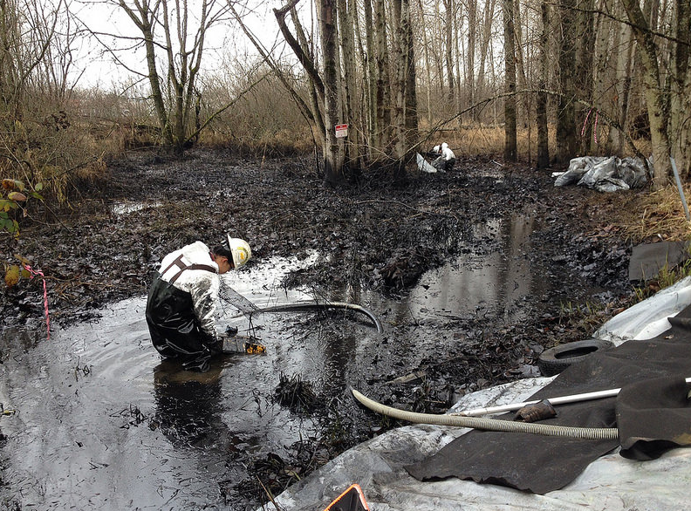

Slide 14
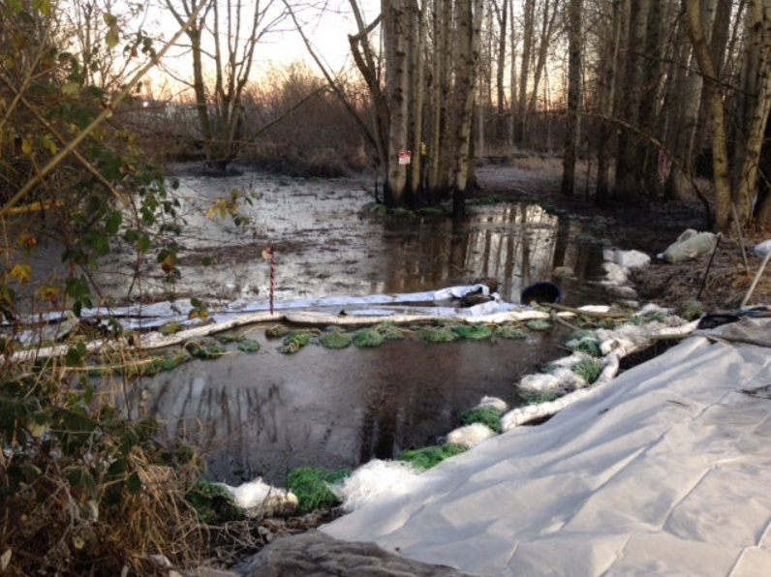

Slide 15
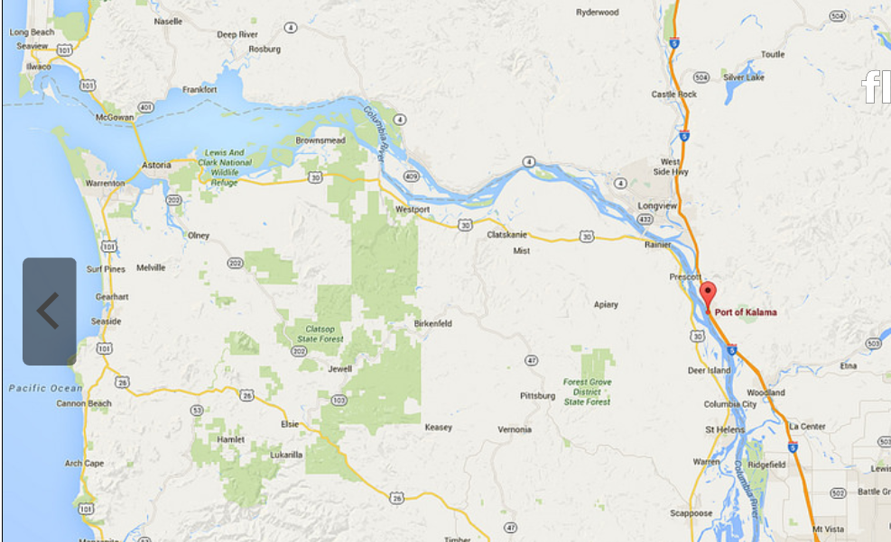
Nord Auckland Spill
February 18, 2016
Vessel Reported 80 gallons of waste oil to water
Significant Resources at Risk

Slide 16
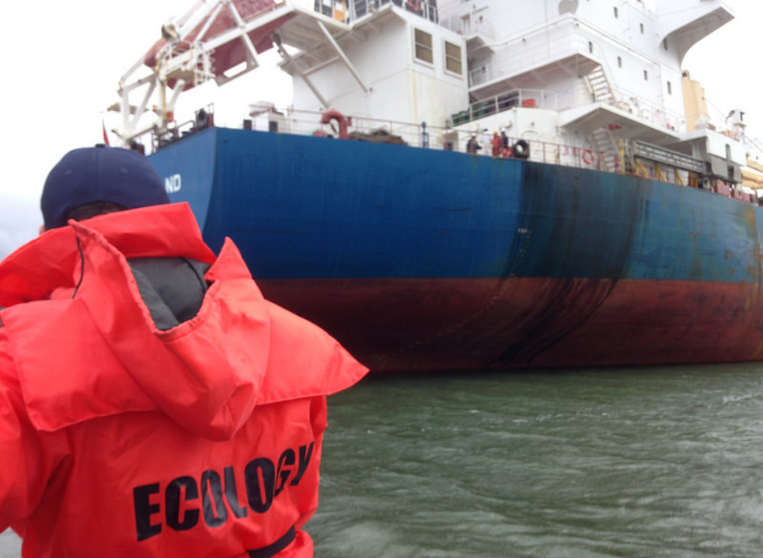

Slide 17
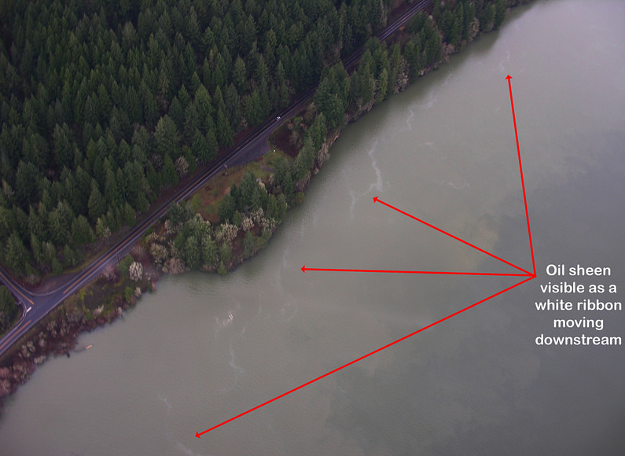

Slide 19
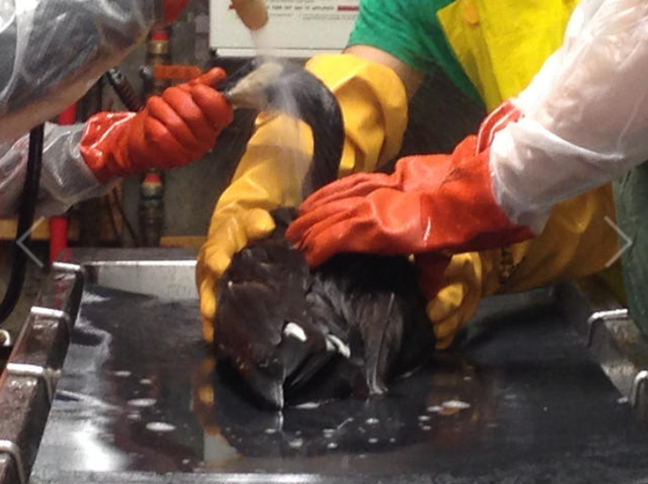
Questions for Washington?

Slide 20
