Slide 1


REGIONAL
HAZARDOUS MATERIALS
RESPONSE TEAMS
CAPABILITIES

Slide 2
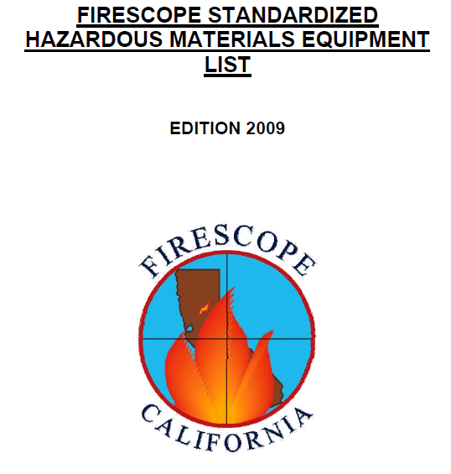
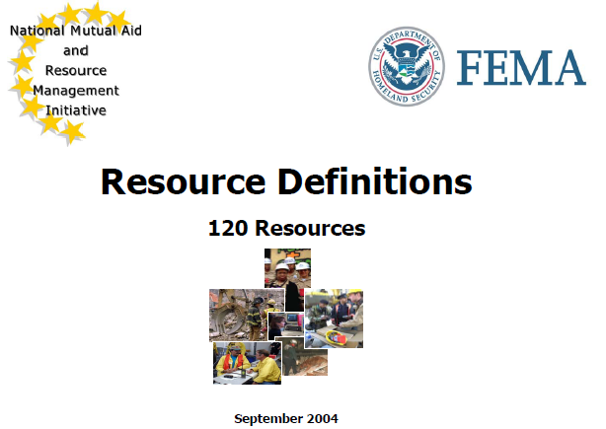
TYPE 1 HAZARDOUS MATERIALS RESPONSE TEAM DEFINITIONS

Slide 3
Field Testing
Known chemicals, unknown chemicals; known or suspect WMD/Chem/Bio
The presumptive testing and identification of chemical substances using a variety of sources to be able to identify associated chemical and physical properties.
Sources include:
  printed and electronic reference resources,
  safety data sheets,
  field testing kits,
  specific chemical testing kits,
  chemical testing strips,
  data derived from detection devices,
  and air monitoring sources.

Slide 4
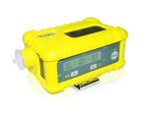
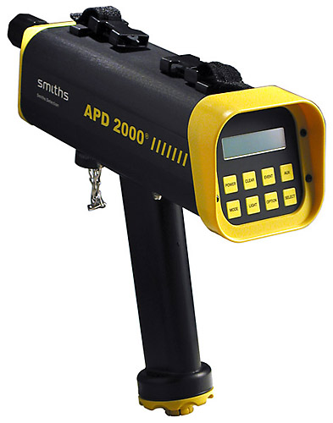
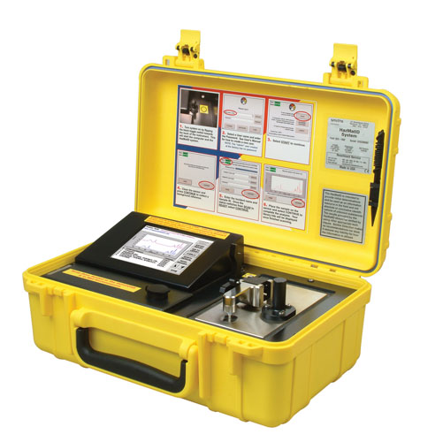
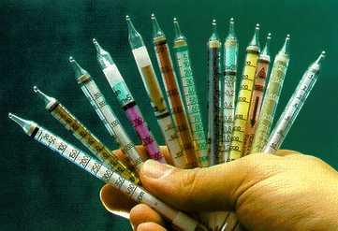
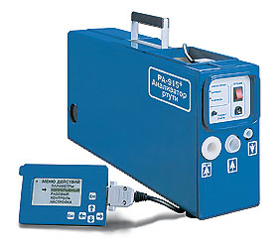

Slide 5
ACHIEVING TIMELY, EFFECTIVE PUBLIC PROTECTION
1st Responders Basic Capability - 4 gas monitor - evacuation
101st CST – Basic + advanced technology and training – confirmation, evidence, documentation
State Labs – Ultimate advanced technology – confirmation, evidence, more documentation, more forensics
RRTs – Advanced Capability – Basic + some advanced technology & training – confirm evacuation and determine re-occupancy
Federal Labs – FBI, EPA, CDC – evidence and third party independent confirmation

Slide 6

Air Monitoring
Basic confined space monitoring specific known gas monitoring; WMD chem/bio aerosol vapor and gas
The use of advanced detection equipment to detect the presence of known or unknown gases or vapors.
The basics begin with ability to provide standard confined space readings (oxygen deficiency percentage, flammable atmosphere LEL, carbon monoxide and hydrogen sulfide).
Advanced detection and monitoring incorporates more sophisticated instruments that differentiate between two or more flammable vapors, and may directly identify by name a specific flammable or toxic vapor.
This includes WMD/chem/bio detection instruments.

Slide 7
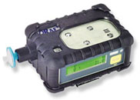
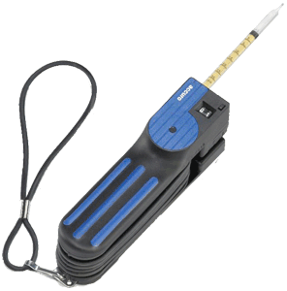
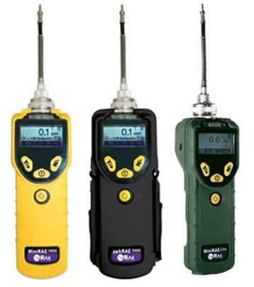
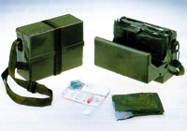

Slide 8

Sampling: Capturing Labeling Evidence Collection
Known industrial chemicals; unknown industrial chemical; WMD chem/bio
Known and unknown industrial chemicals standard evidence collection protocols required for each include:
  capturing and collections,
  containerizing and proper labeling,
  and preparation for transportation and distribution, including standard environmental sampling procedures for lab analysis.
Consistent with established chain of custody protocols.
Ability to sample liquids and solids.
Special resources are required for air sample collection.

Slide 9
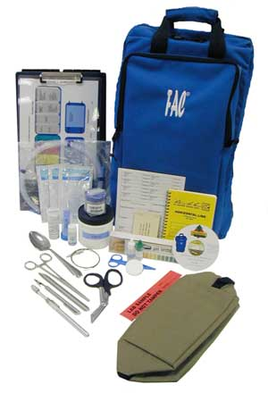
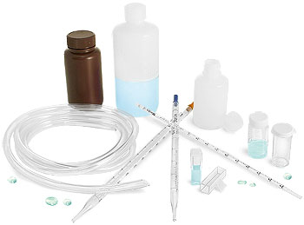

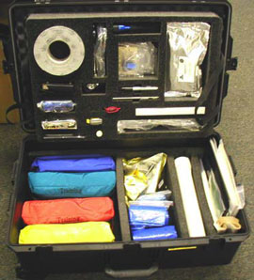
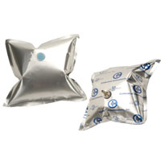
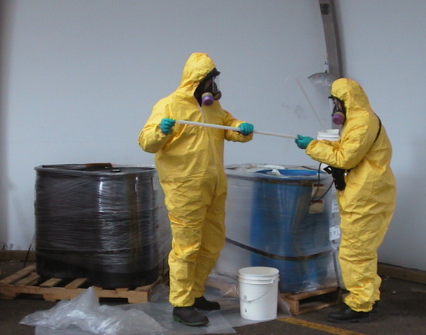
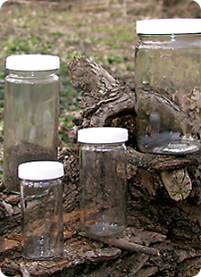

Slide 10

Radiation Monitoring/Detection
Alpha detection; beta detection; gamma detection
The ability to accurately interpret readings from the radiation-detection devices and conduct geographical survey search of suspected radiological source or contamination spread.
Identify and establish the exclusion zones after contamination spread (this does include identification of some, but not all, radionuclides).
Ability to conduct environmental and personnel survey. Basic criteria include detection and survey capabilities for alpha, beta, and gamma.
All members of survey teams are equipped with accumulative self-reading instruments (dosimeters).

Slide 11
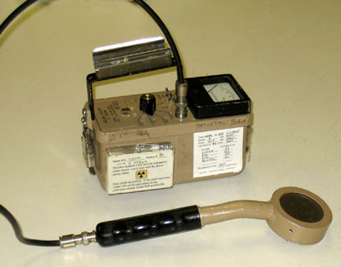
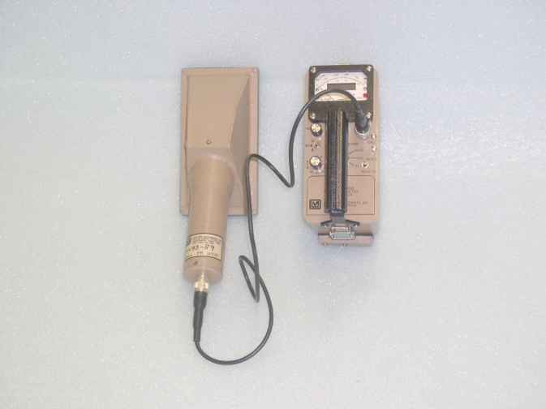
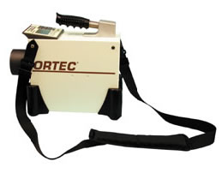
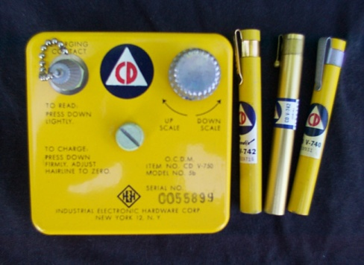
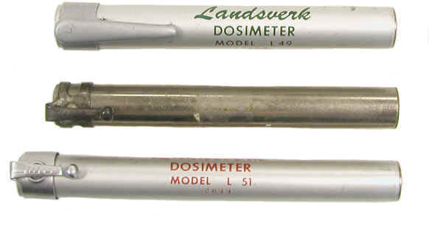
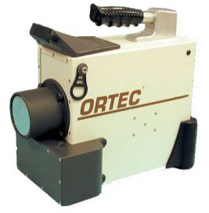
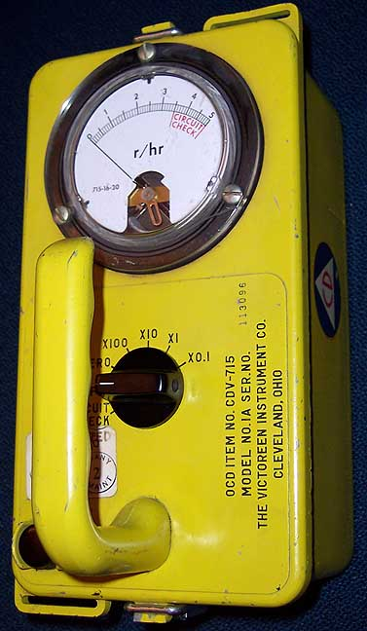
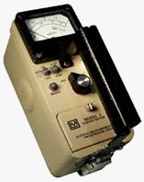
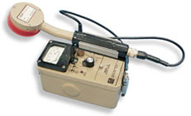

Slide 12
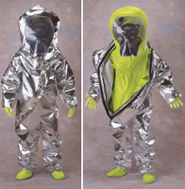
Protective Clothing: Ensembles
Vapor-protective CPC; WMD vapor-protective CPC; Flash fire vapor-protective CPC; liquid splash-protective CPC; WMD liquid splash-protective CPC
Chemical protective clothing (CPC), which includes complete ensembles (suit, boots, gloves) and may incorporate various configurations (encapsulating, non-encapsulating, jumpsuit, multi-piece) depending upon the level of protection needed.
Levels of CPC vapor protection are:
  Vapor-Protective,
  Flash Fire Protective option for Vapor-Protective,
  and Chemical/Biological-Protective option for Vapor-Protective,
All of which must be compliant with:
(NFPA) Standard # 1991, “Standard on Vapor-Protective Ensembles for Hazardous Materials Emergencies” current edition.
Level of CPC liquid protection is: Liquid Splash-Protective, which must be compliant with NFPA Standard # 1992, “Standard on Liquid Splash-Protective Ensembles and Clothing for Hazardous Materials Emergencies”, current edition

Slide 13
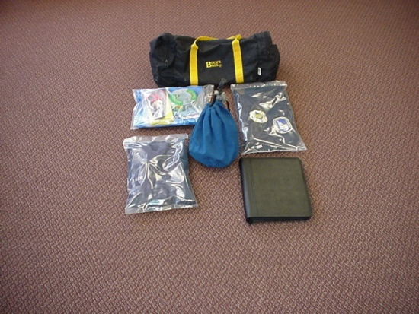
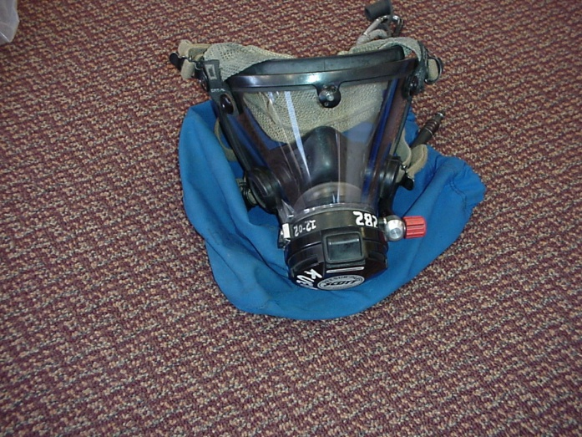
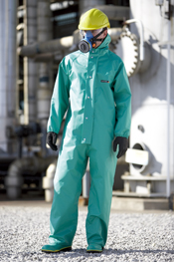
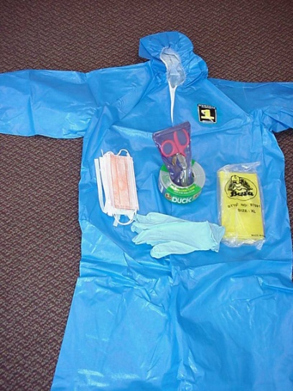

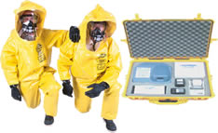
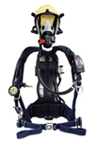

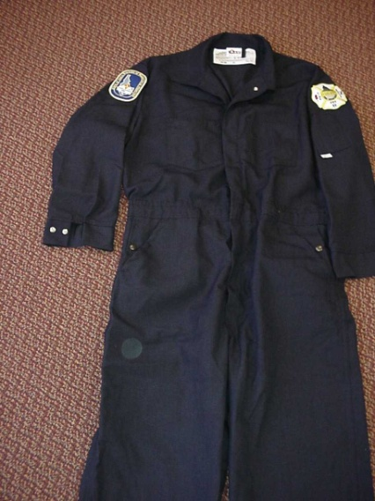
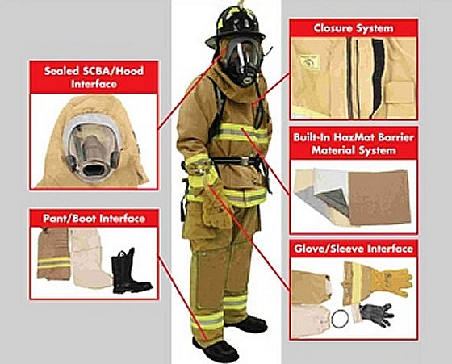


Slide 14

Technical Reference
Printed and Electronic; Plume Air Modeling; Map Overlays; WMD Chem/Bio
Access to and use of various databases, chemical substance data depositories, and other guidelines and safety data sheets, either in print format, electronic format, stand-alone computer programs, or data available via telecommunications.
The interpretation of data collected from electronic devices and chemical testing procedures.
At a minimum, technical references will have the ability to outsource additional capabilities and have one source for air-modeling capability.

Slide 15









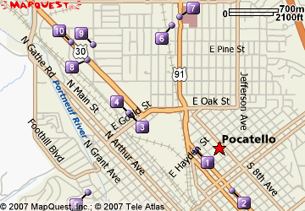

Slide 16
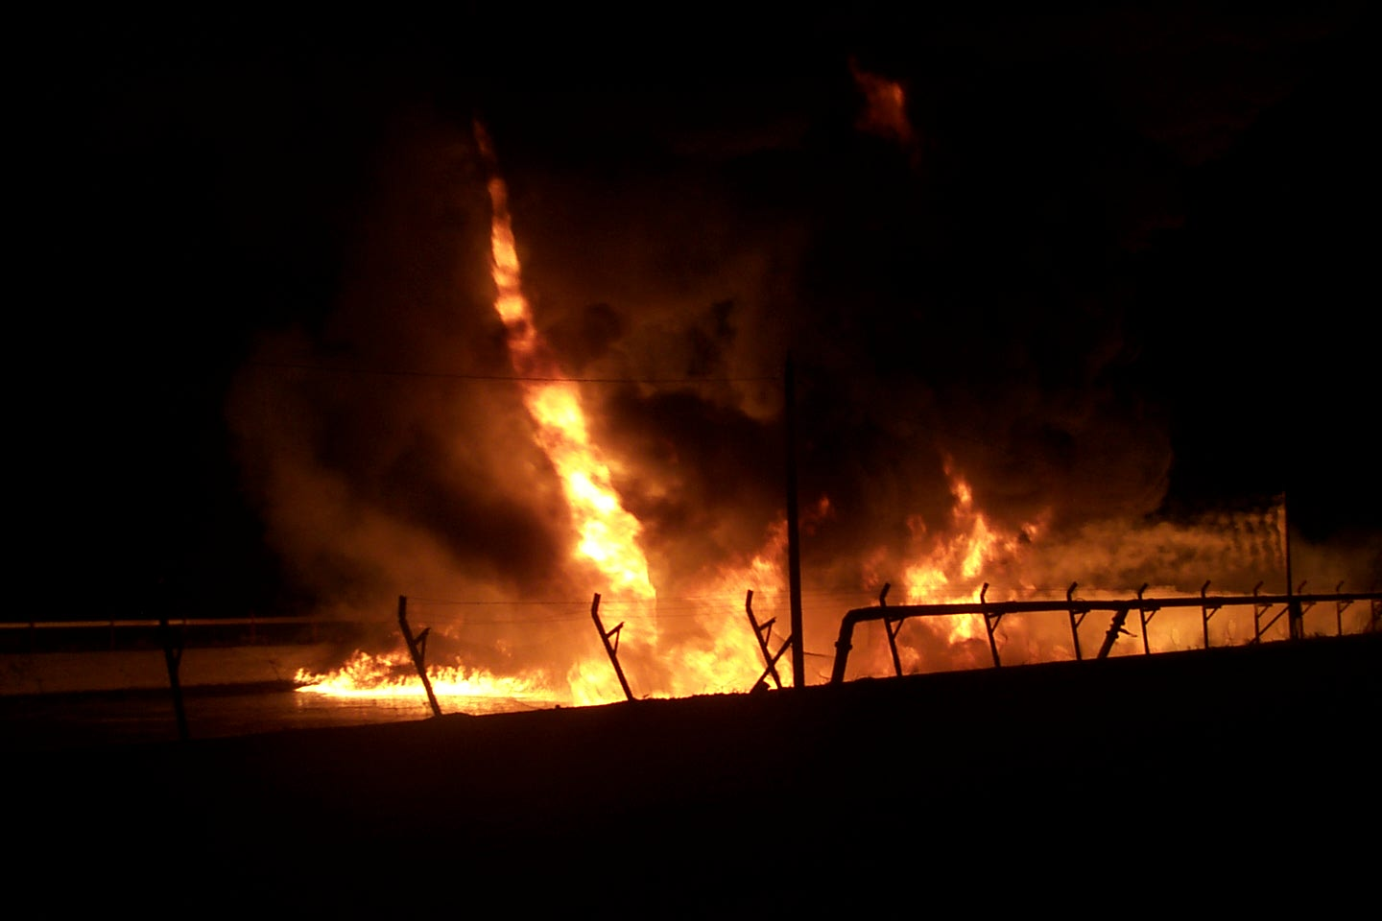
Special Capabilities
Specialized Equipment Based on Local Risk Assessment;
  Heat Sensing Capability;
  Light Amplification Capability;
  Digital Imaging Documentation Capability
Additional resources that augment the capabilities of the team.

Slide 17
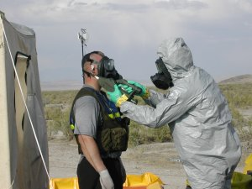
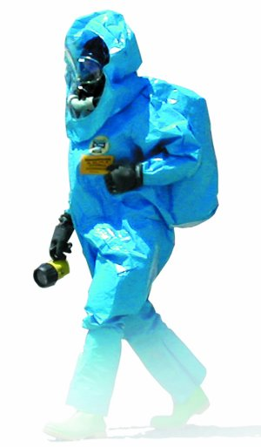
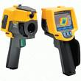
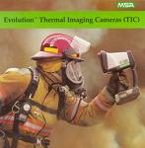
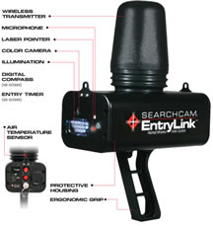
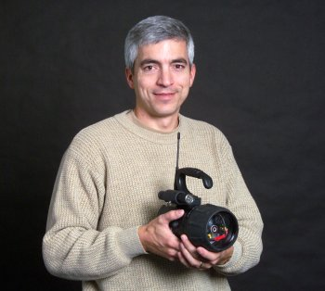

Slide 18
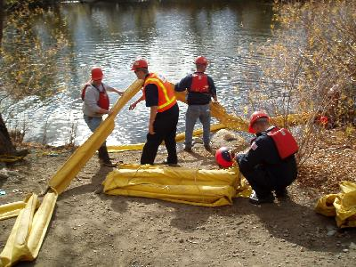
Intervention
Diking; Damming; Absorption; Liquid Leak Intervention; Neutralization; Plugging; Patching; Vapor Leak Intervention WMD Chem/Bio Agent Confinement
Employment of mechanical means of intervention and control such as plugging, patching, off-loading, and tank stabilization;
Environmental means such as absorption, dams, dikes, and booms;
Chemical means such as neutralization and encapsulation of known and unknown industrial chemicals.
Mechanical means include specially designed kits for controlling leaks in rail car dome assemblies and pressurized containers, to pneumatic and standard patching systems.
Advanced capabilities include ability to intervene and confine incidents involving WMD Chem/Bio substances.

Slide 19
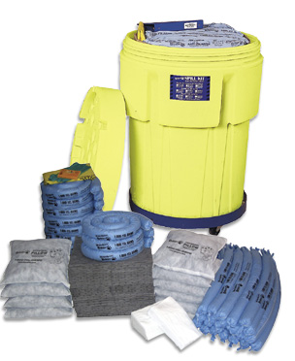

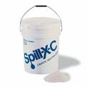


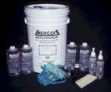
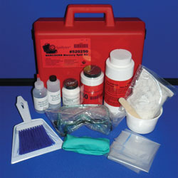


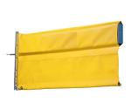

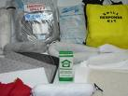



Slide 20

Decontamination
Known Contaminants Based on Local Risk Assessment;
Unknown Contaminants;
WMD Chem/Bio
Must be self-sufficient to provide decontamination for members of their team.
Capable of providing decontamination for known and unknown contaminants and WMD Chem/Bio.

Slide 21











Slide 22

Communications
In-Suit;
Wireless Voice;
Wireless Data;
Secure Communications
Personnel utilizing CPC are able to communicate appropriately and safely with one another and their team leaders.
Communications with State Comm from the field are also included.
New technology, including satellite, communications are being studied and may soon be deployed by some teams.

Slide 23







Slide 24

Personnel Staffing
minimum of 5 personnel
29 CFR 1910.120 – section Q
  Buddy system
  Back up
  Decon
  Safety
  Incident Commander

Slide 25
Regional Haz Mat Team
Response Configuration Guide
RRT Configuration | Basic | Full | Multi-Team
Initial Assignment (May be augmented by local resources) | HM Group Sup/Safety Officer (1-2) Decon (2) Entry (2) Local resource as required: Local FD engine co. Local EMS w/transport Local Law Enforcement Special resources (EOD, CST, etc.) | HM Group Sup (1) HM Safety Officer (1) Entry (2) Back Up (2) Science/Analysis (1-2) Decon (2) Special resources (EOD, CST, etc.) Local resource as required: Local FD Local w/transport Local Law Enforcement | Full RRT response (2 +) Mass Casualty Decon Team (1-2 +) 101st CST Other State and Federal Resources Local resources as required: Activate and Emergency Plan

Slide 26

Personnel Training
All personnel must be trained to the minimum response standards in accordance with the most current editions of NFPA Standard # 471, “Recommended Practice for Responding to Hazardous Materials Incidents,”
NFPA Standard # 472, “Standard for Professional Competence of Responders to Hazardous Materials Incidents,”
and NFPA Standard # 473, “Standard for Competencies for EMS Personnel Responding to Hazardous Materials Incidents,” as is appropriate for the specific team type.

Slide 27





RRTs

Slide 28

Sustainability
Capability to perform a minimum of three (3) Entries in a 24-hour Period
Multiple Team Response
Grants:
  HSGP
  DOT
Personnel turnover

Slide 29

Region 1 – RRT1, RBS, ICSAR1
LEGEND:
RRT – Regional Haz Mat Response Team
RBS – Regional Bomb Squad
ICSAR – Idaho Collapse Search & Rescue Team
IIMAST – Idaho Incident Management & Support Team
Region 2 – RRT2
IIMAST – statewide team
Region 7 – RRT7, RBS, ICSAR 3B
Region 3 – RRT3, RBS
Region 6 – RRT6, ICSAR 3A
Region 4 – RRT4, RBS, ICSAR 2
Region 5 – RRT5, RBS

Slide 30


QUESTIONS ???

Slide 31


FOR ANSWERS, CALL:
Jeff Rylee
Idaho Bureau of Homeland Security
208-422-5724
jrylee@bhs.idaho.gov

